Slide 1



A Deep Learning Architecture for Enhanced Depth Estimation on an unrectified Stereo 360◦ dataset
Supervisor: Prof. Antonello Rizzi
Co-Advisors: Prof. Alexandre Masoud Alahi
Ing. Enrico de Santis
Correlatore: Prof. Giuseppe Scotti
Candidate: Danial Zendehdel
Master's Degree in Electronics Engineering
Graduation session of May 2023

Slide 2
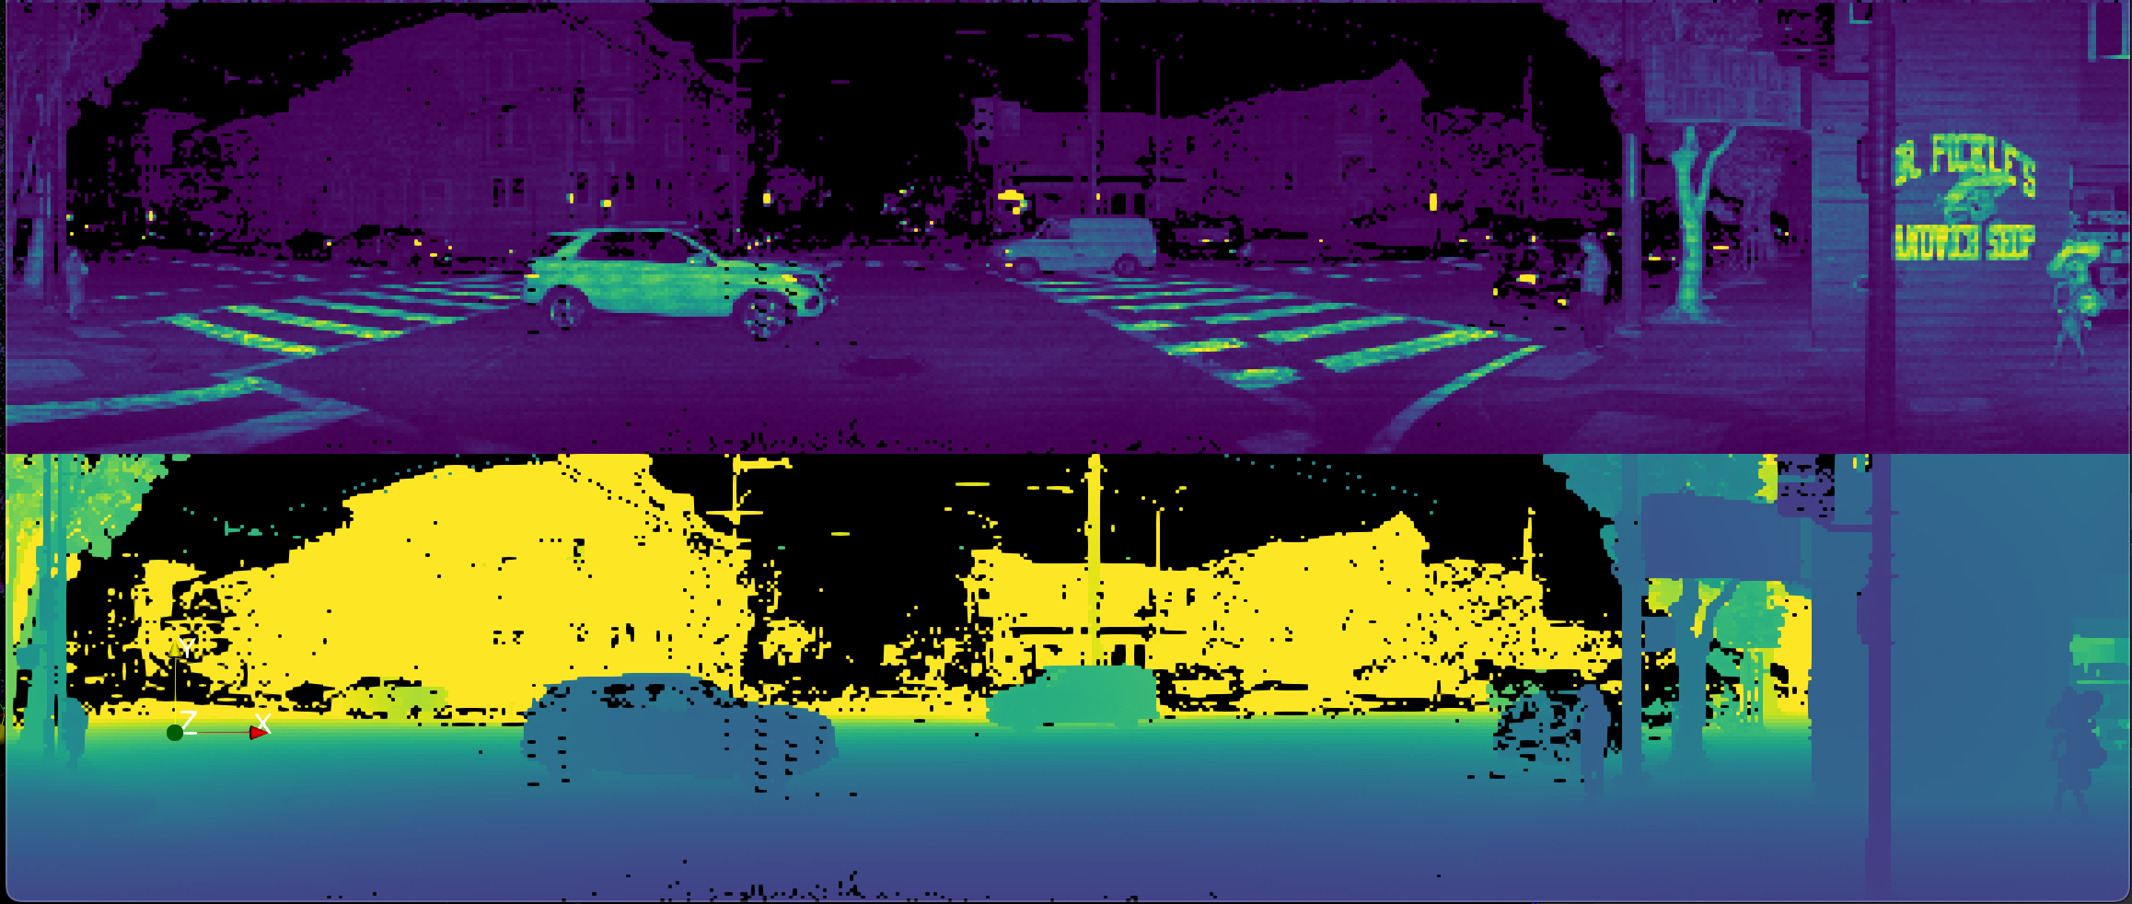
Motivation
Applications
Transportations
Self driving cars
Unmanned aerial vehicles
Robotics and Automation
Augmented Reality
Datasets
KITTI
MP3D
SF3D
Techniques
Stereo Matching
Deep Learning
Sensor Fusion
Tools
Stereo vision (360°Cameras)
Lidar
Radars
Ultrasonic Sensors
Notes:
The fact that autonomous vehicles should accurately perceive the world in 3D is one of the primary obstacles to generalised self-driving cars. Computer visions algorithms has made great stride in 2D tasks such as object detection, segmentations, human pose estimation, however the result of the corresponding 3D tasks are still lagging behind.
Effectiveness of deep learning-based systems for 3D tasks is influenced by two key variables, first of all, interacting with world’s 2D projections is simpler than perceiving it in 3D, this is especially true in autonomous driving situations and on the other hand these deep learning models trained on smaller datasets such as KITTI, SF3D, MP3D.
In order to tackle the 3D issue, different algorithms had been implemented with ,Deep learning , stereo matching or even sensor fusion techniques. And each of these techniques had perceived the world with different data acquisition tools such as Stereo vision cameras , lidar or radar.

Slide 3
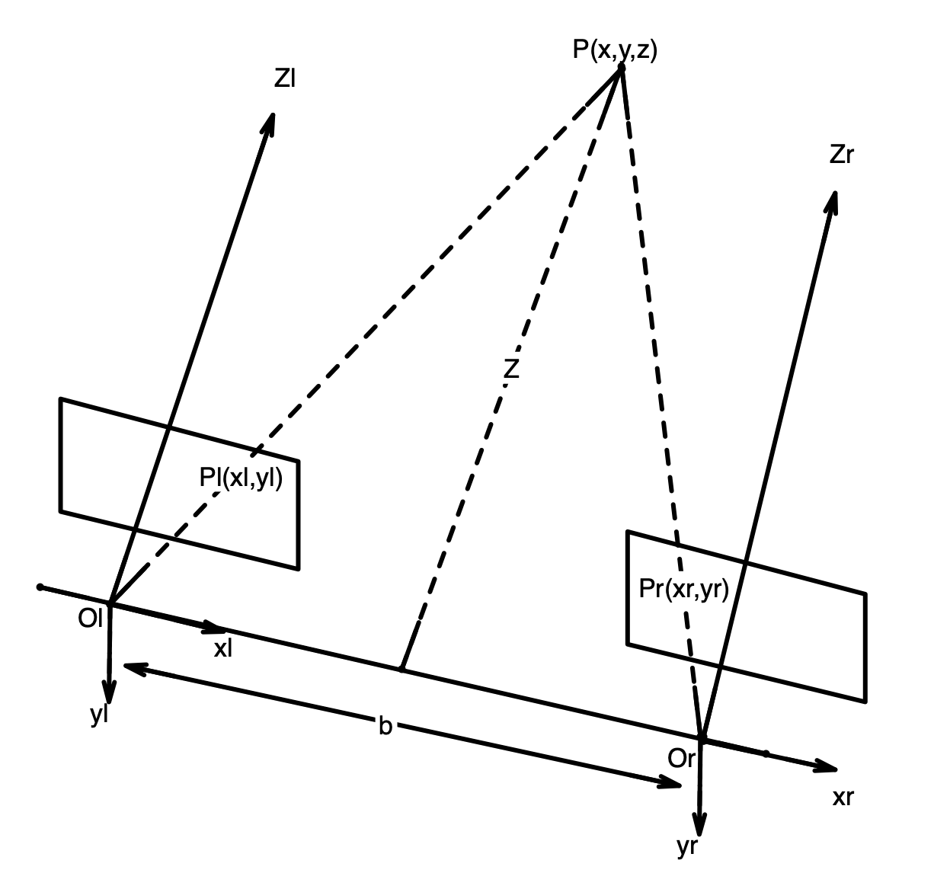
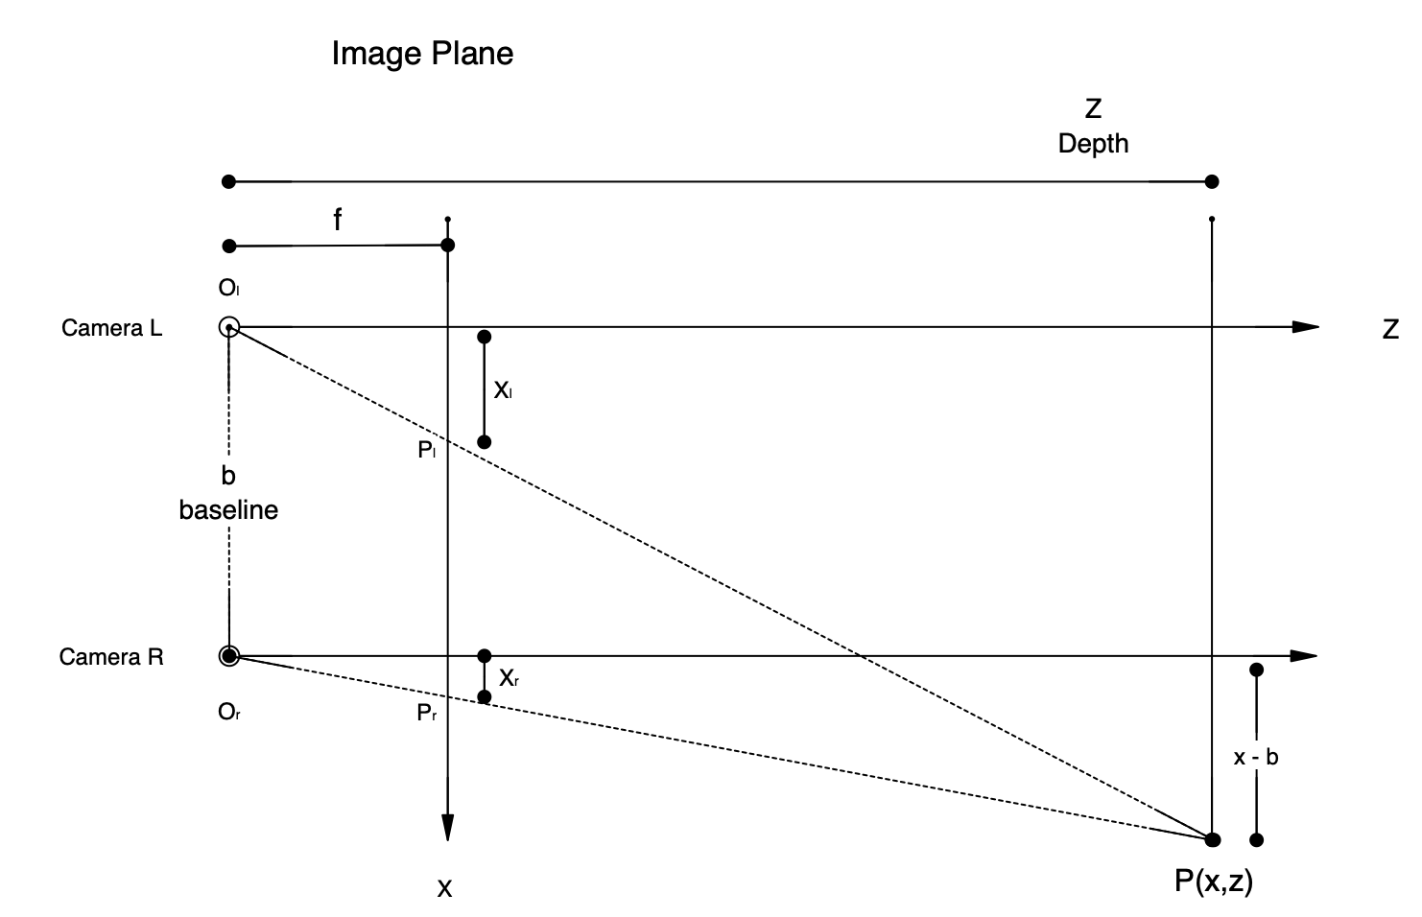
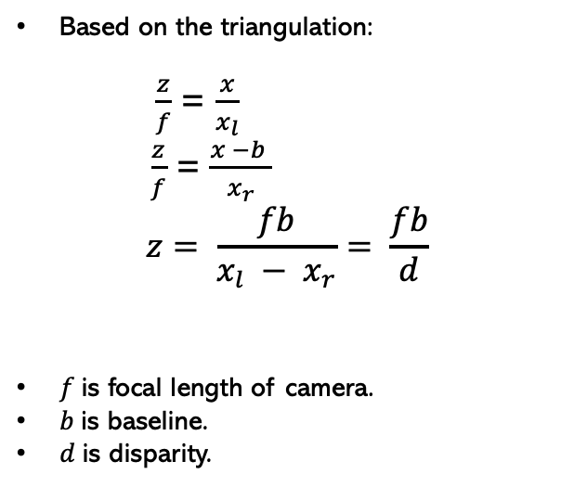
The State of The Art Pinhole Camera
Based on the triangulation: $\frac{z}{f}$ = $\frac{x}{x_{l}}$
$\frac{z}{f}$ = $\frac{x −b }{x_{r}}$
$$z= \frac{fb}{x_{l} − x_{r}}= \frac{fb}{d}$$
$f$is focal length of camera.
$b$is baseline.
$d$is disparity.
The model of Binocular Stereo Vision
Notes:
In order or understand the concept of depth estimation we can consider 2 cameras such as human eyes which are looking at a point. in this case According to the principle of triangulation, two parallel and coplanar cameras are used to capture the same scene from different angles, and the depth information is recovered by calculating the parallax value between the image pairs. As shown in the figure, the optical centre positions of the left and right cameras are Ol and Or respectively, Ol- (x, y, z) l and Or - (xr, tr, zr) are the cameras coordinates systems, b is the. Baseline and f is the focal length and pr and pl are the projection of the point x,y,z on the two camera coordinates. And based on the triangulation we have derive

Slide 4
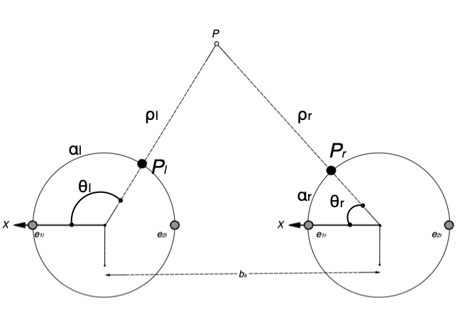
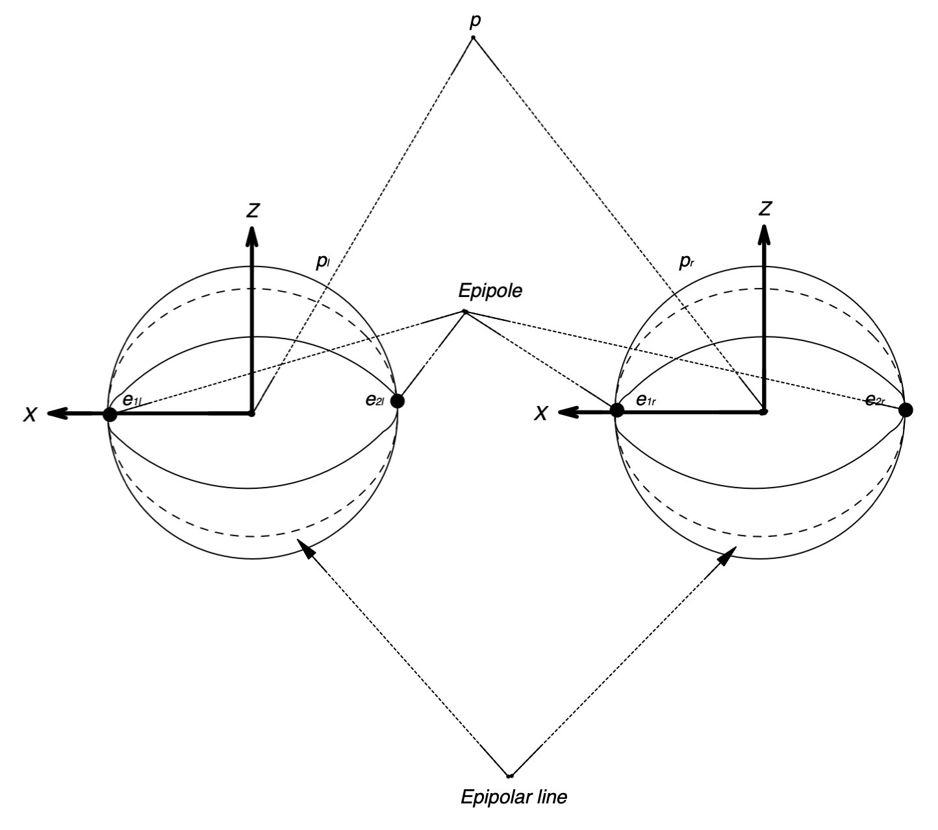
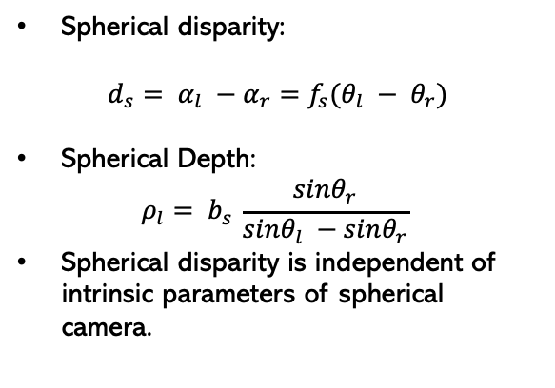
The State of The Art Spherical Camera model
b)
Spherical disparity:
$$d_{s}= α_{l} −α_{r}=f_{s}(θ_{l} − θ_{r})$$
Spherical Depth:
$$ρ_{l}= b_{s }\frac{sinθ_{r}}{sinθ_{l} −sinθ_{r}}$$
Spherical disparity is independent of intrinsic parameters of spherical camera.
a)
a) Spherical stereo. A point is observed by a pair of spherical cameras. b) Bird-eye view of a).
Notes:
Same concept In the case of the spherical cameras which is our case is shown in this slide
Imagine a pair of spherical cameras that capture images using spherical projection, we assume that the camera coordinate systems’s axes are parallel to each other and the x-axes are aligned The baseline of this spherical stereo setup is represented by the line connecting the two focal points.
The epipoles in each spherical image are the points where the baseline intersect the image on the x-axis
In order to define disparity consider
angles formed by the projection of point P onto the spherical images and the x-axis are ${\theta}_l$ (polar angle relative to the x-axis) and ${\theta}_r$, respectively. We define the disparity, $d_s$, of point P as the difference between the arc lengths $\alpha_l$ and $\alpha_r$, which are subtended by the angles ${\theta}_l$ and ${\theta}_r$, respectively. ,
The spherical disparity is independent from intrinsic parameters of spherical camera

Slide 5
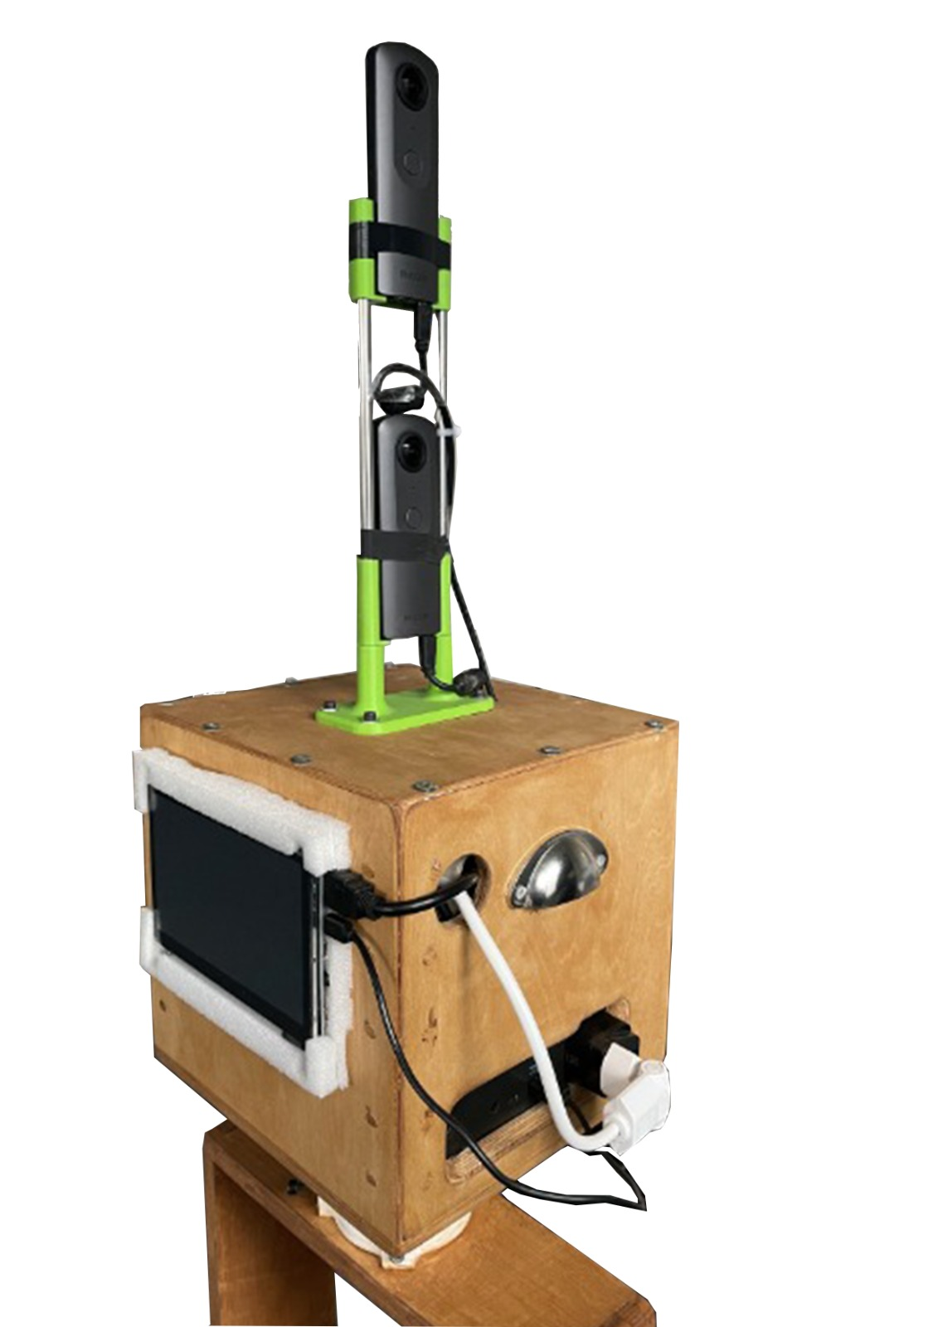

Dataset Setup
Components
Two 360°Ricoh Theta V cameras.
Lidar Ouster OS1, 64
Jetson AGX Xavier, (Ubuntu 18.04)
Liteon Battery
LCD screen
Controller
Data acquisition setup.
Page 5
Notes:
Our setup is composed of: two 360 cameras
Lidar : the output is panoramic form of with a vertical angle of 24 degree is limitation leads to have depth map with 64 in terms of height.
Jetson
Liteon battery
Lcd

Slide 6
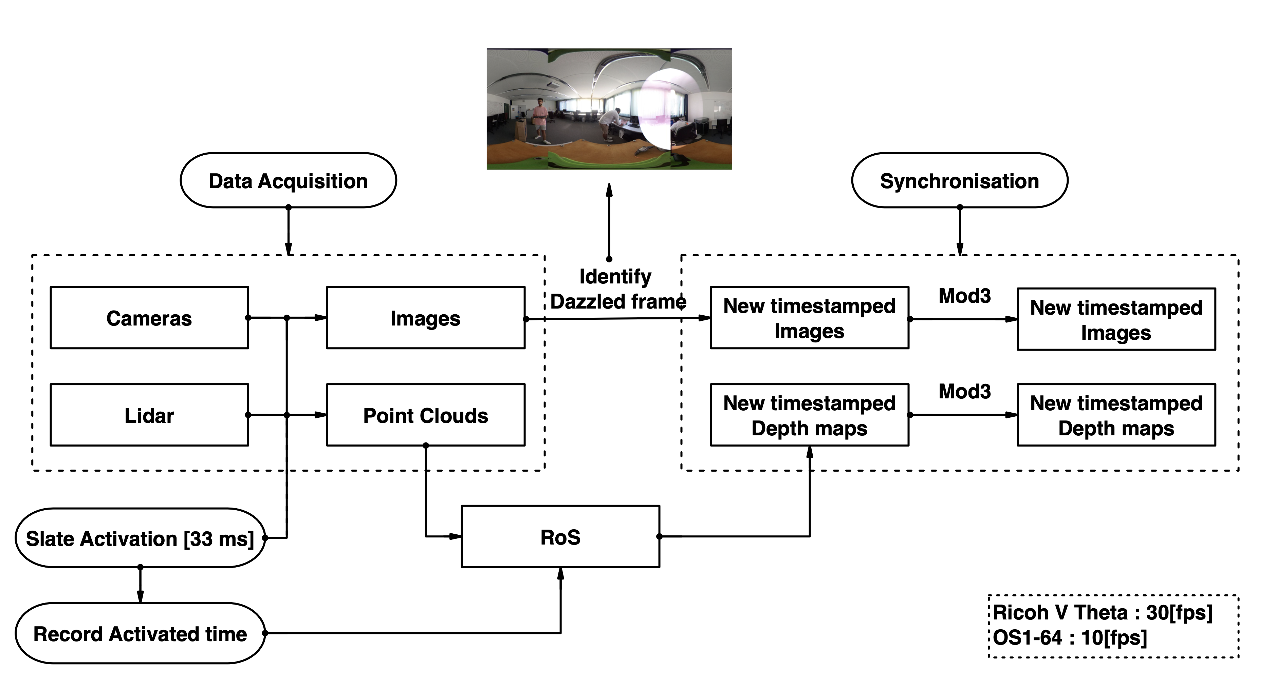
Dataset Synchronization
Synchronization diagram.
Notes:
Synchronisation:
The Ricoh cameras captures images with 30 fps while the Lidar has a 10 fps, in the case of Real-time synchronisation the RoS waits for lowest frequency device to catch the frames, this procedure was not possible in our case as the transition time for cameras were different.
So as a alternative post recording synchronisation had been chosen. In this case we record independently with cameras and lidar, and while we are recording a flash would be activated, the activation time would be recorded which be used for lidar and this flash would dazzled a frame in cameras frames (for 33 ms). This exactly works as slate in film shooting and only impact one frame. So after the recording the dazzled frame should be identified for each camera and then the previous frame would be deleted and the rest would be reordered. Regarding the lidar the recorded activation time would be used.
As the last step as the lidar and cameras have different fps we have to take mod3 of those, the maximum delay in this case would be 15ms and it can be considered as the best synchronisation that can be achieved.

Slide 7
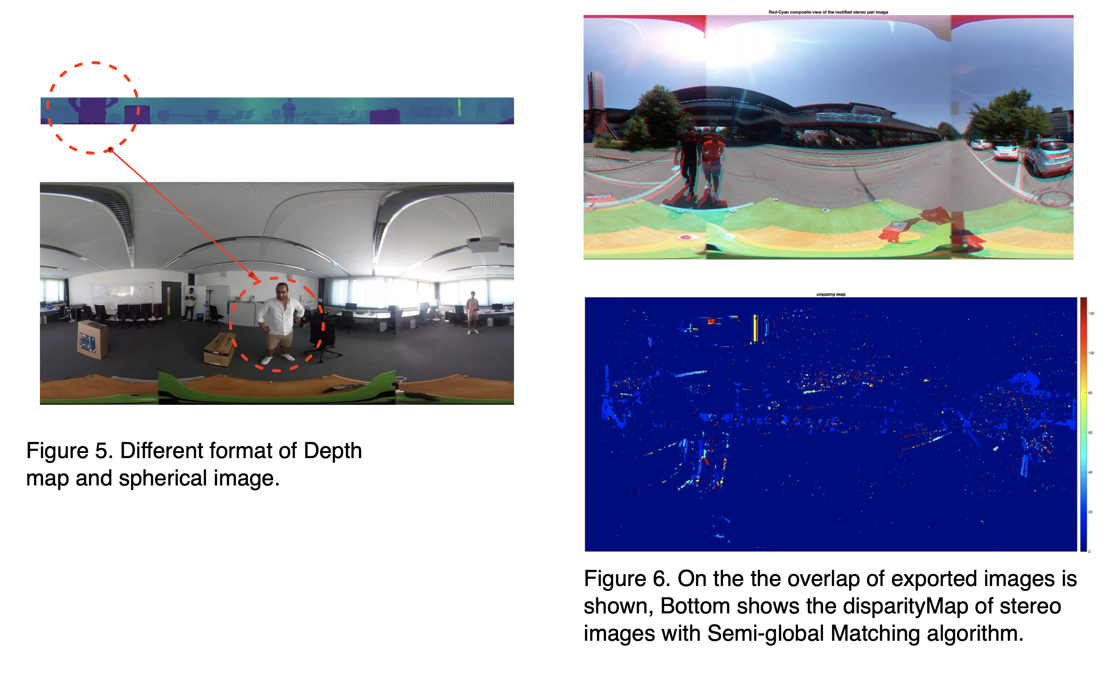


Dataset Format matching & Rectification
Different format of Depth-map and Spherical images
Camera’s image size: 3840 × 1920
Depth-map: 1024×64
On top the overlap of the images is shown, Bottom shows the disparity-map of stereo images with semi-global matching system
Notes:
The cameras images are spherical while the lidar’s depth-map are panoramic and also the field of view of lidar is subset of FoV of cameras, one possibility is remove the top and bottom of cameras images to have the same FoV and on the other hand it could be possible to save images as they are and process them in preprocessing section of the code. Based on the fact that spherical images have barrel effect it would be possible to just crop it to have less of this effect and textureless areas and then use bigger images compare to their ground truth as 64 in terms of height is desirable.
Regarding the rectification, in order to generalise model, we decided to not rectify images and figure shows the overlap of top and bottom images and their disparity map which proves that our data is not rectified.

Slide 8
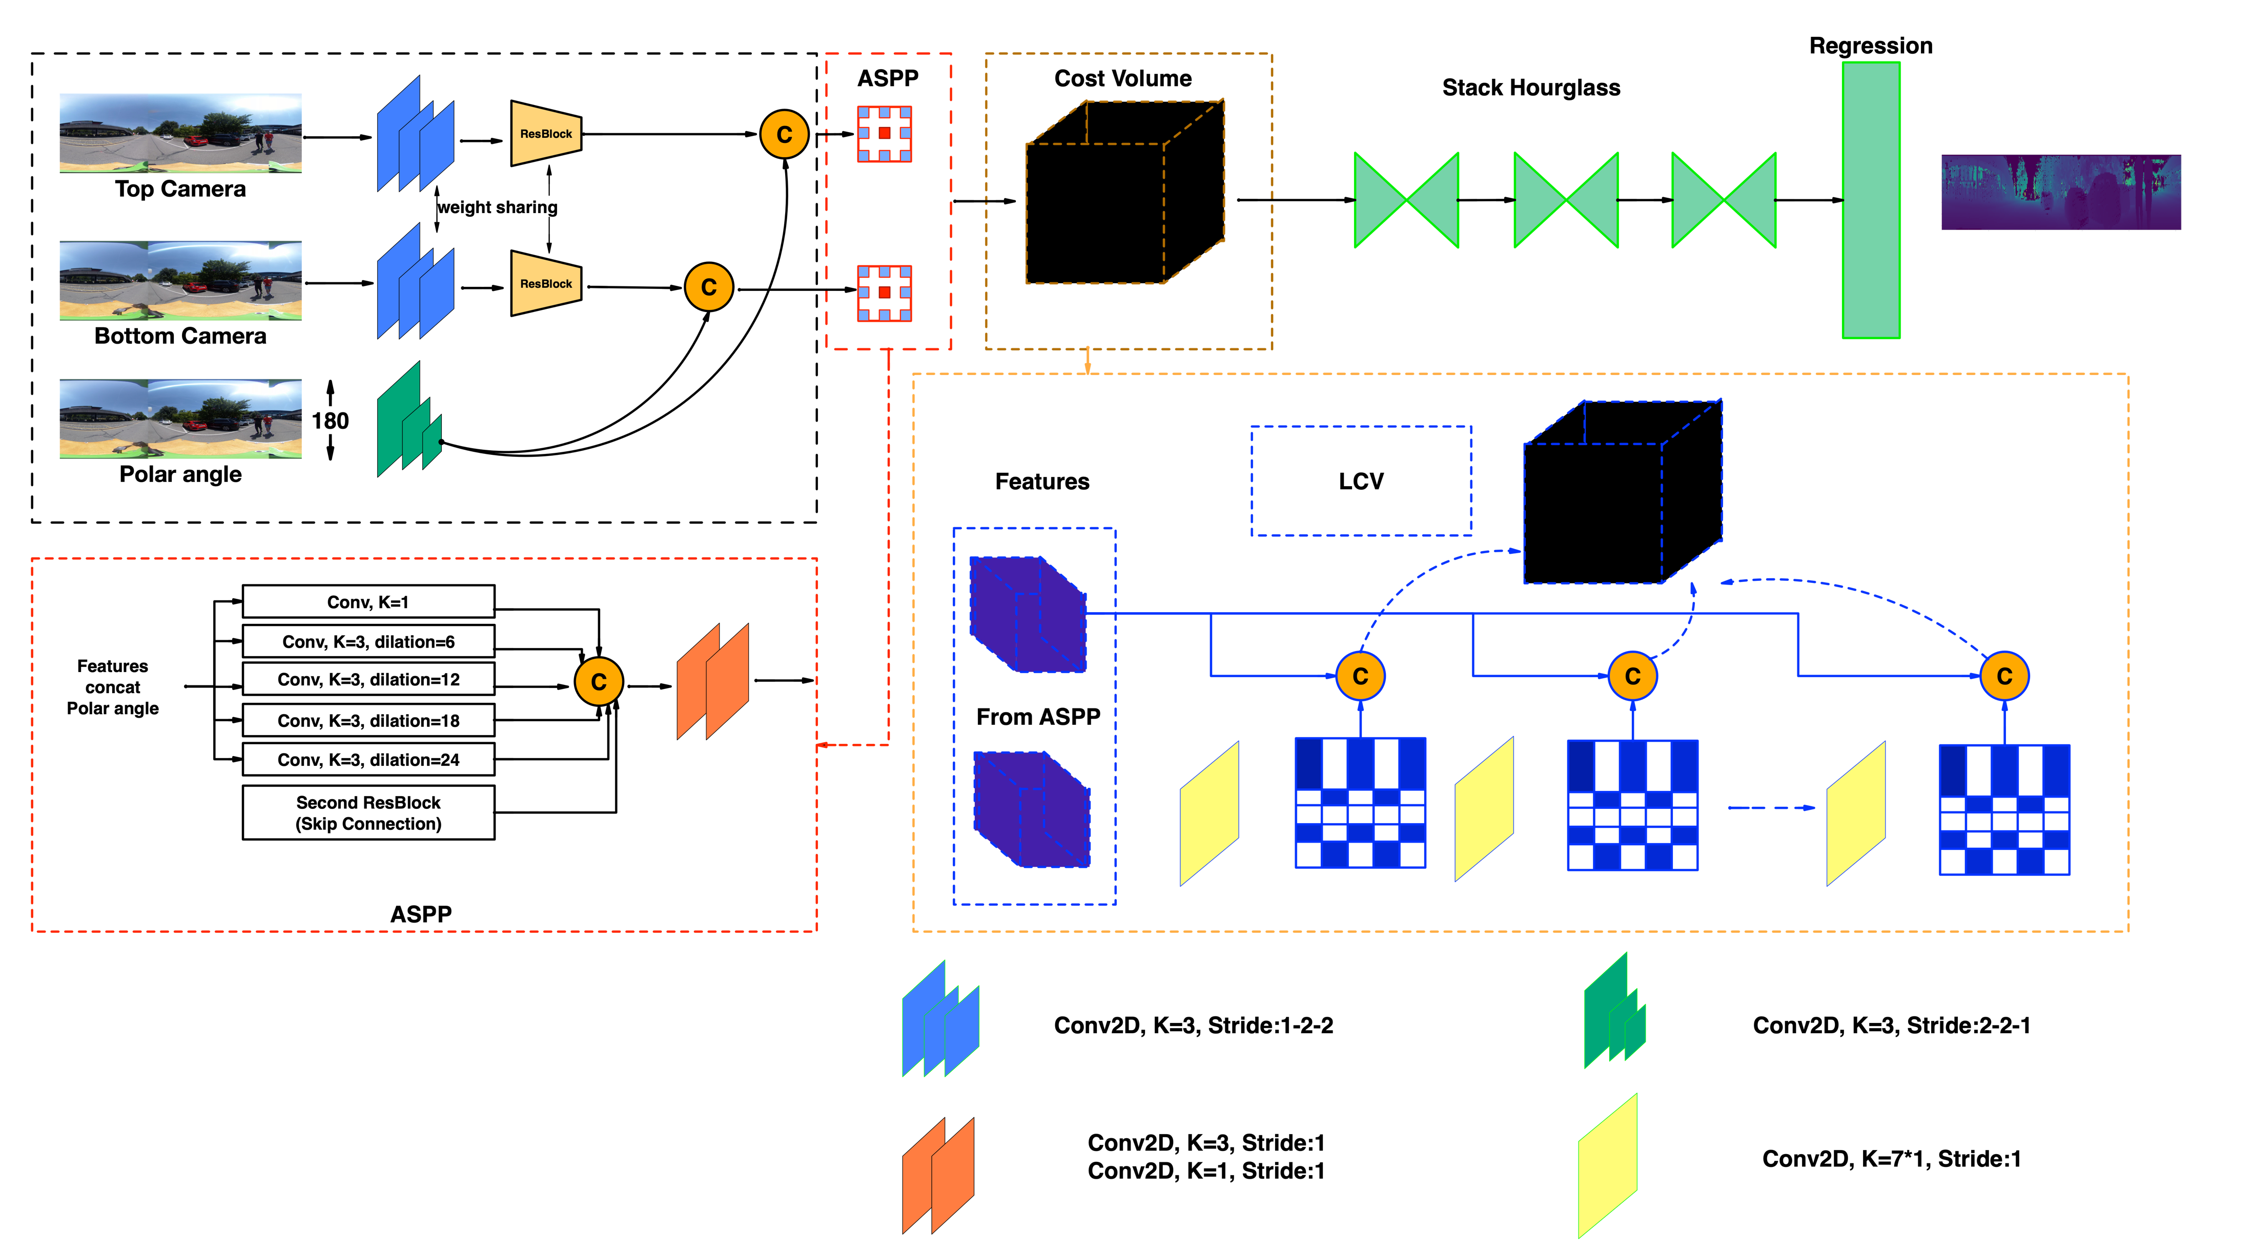
Network Architecture Architecture
The network primarily comprises three components: a) a dual-branch feature extractor that combines stereo equirectangular images with polar angles in a late fusion setting, b) an ASPP module designed to expand the receptive field, and c) a learnable cost volume that accommodates the nonlinear spherical projection. A Stacked-Hourglass module is employed to generate the final depth map.
Notes:
feature extractor is composed of residual layers, which helps to get deeper without degradation in result.
In order to avoid distortion due to the spherical images such as textureless areas like sky or barrel effect in spherical images, 360SD-Net claimed that adding polar angle would help and studied the effects of polar angle in pre concatenation and late fusion which concluded post concatenation has a better result and we used this approach. The aim could be adding geometry information.
Cost volume :
It is a 3D data structure representing the matching costs (or similarity) between corresponding pixels or regions in a pair of stereo images, at different disparity levels. To compute the Cost Volume, a similarity metric such as the Sum of Absolute Differences (SAD) used, Matching costs are calculated for each pixel in the reference image and its corresponding pixels in the target image at different disparity levels, and these costs are stored in the Cost Volume. This results in a structure with dimensions (height × width × disparity × feature size). This approach uses Spatial Pyramid Pooling (SPP) features to enhance stereo-matching.
In typical 3D cost volumes, the step size is one pixel. However, with the distortion introduced by equirectangular projection, the per-pixel step size is inconsistent with the geometry information from the polar angle input. To address this issue, a novel learnable cost volume (LCV) can be introduced using a shifting filter, which searches for the optimal step size in "degree unit" to construct the optimal cost volume.
The ASPP module uses different dilation rates to capture features at different scales. Astrous convolution applies convolutions with gaps between kernel values.. The gaps control the output feature map’s spatial resolution, which leads to have a larger receptive field without increasing the number of parameters. And pyramid pooling technique generate a fixed length vector for each divided region of feature map The fixed-length vectors from each region are concatenated to form the final feature vector, allowing the network to capture features at multiple scales and improving the accuracy.

Slide 9
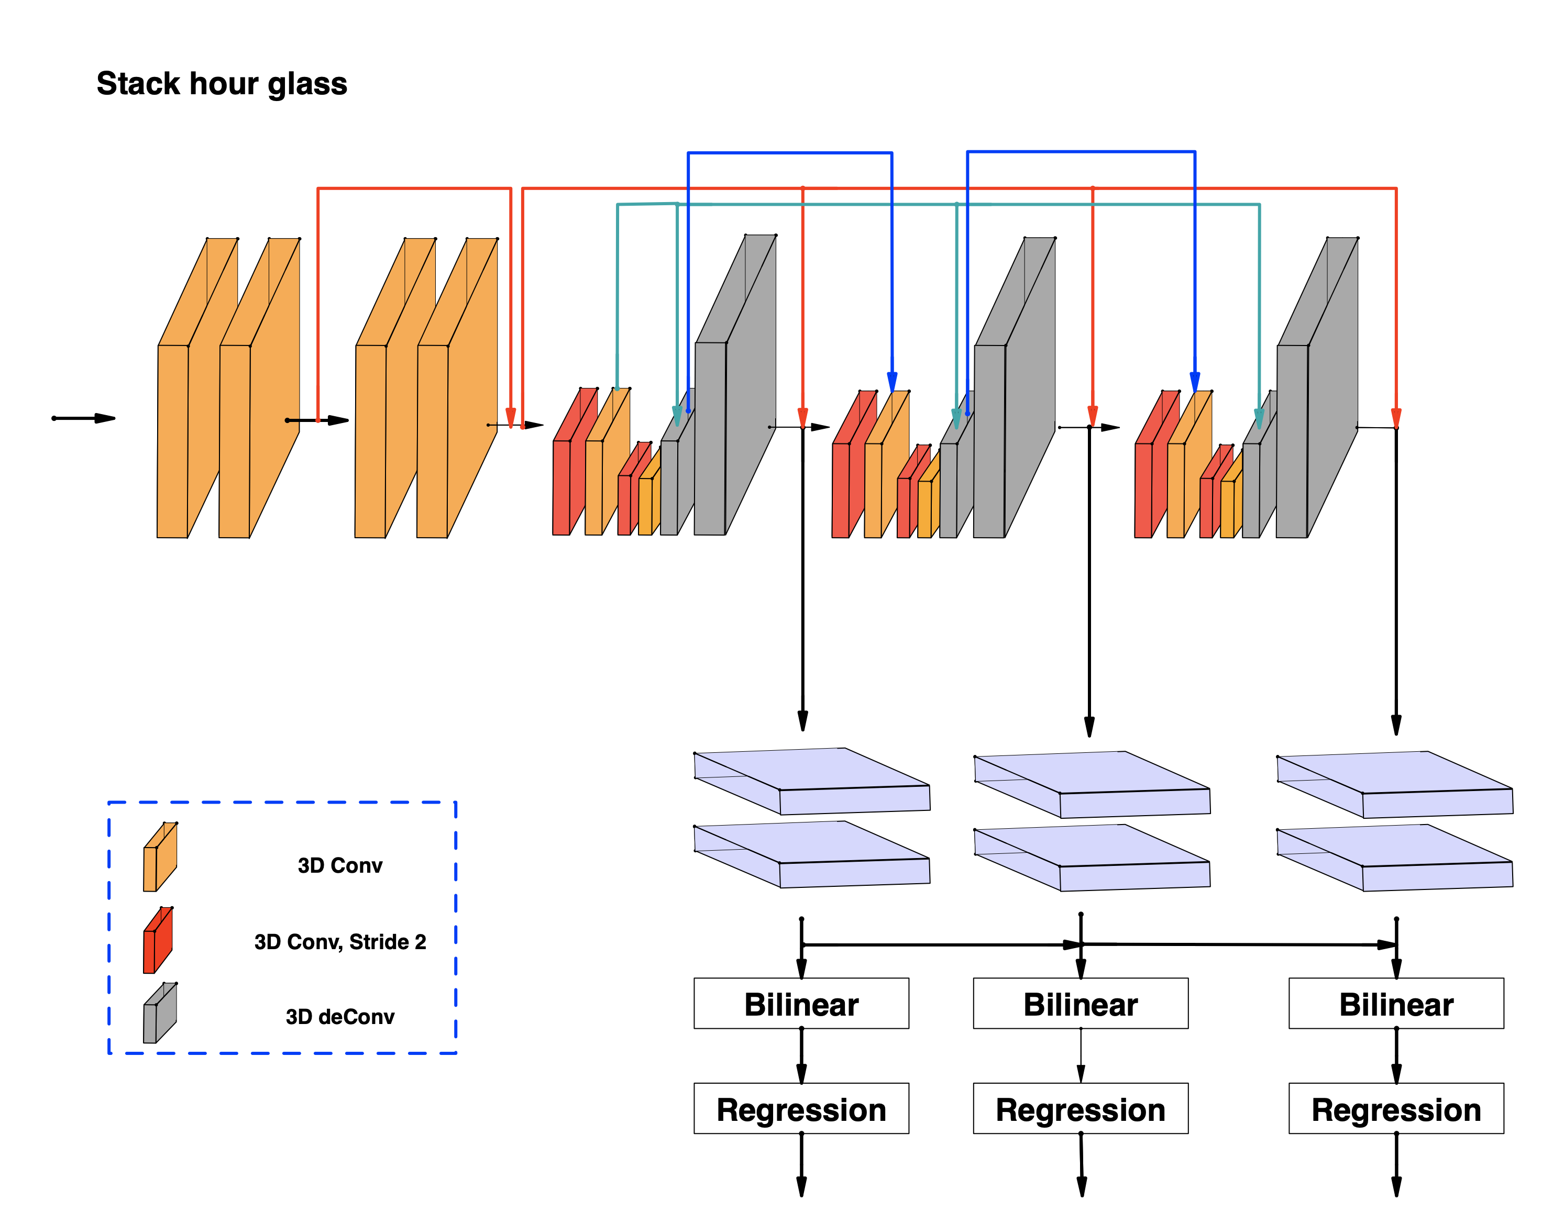
Network Architecture Stack Hour-glass
Cost 1
Cost 2
Cost 3
Complete Stack hour-glass architecture
Notes:
to regularize and improve the cost volume, particularly in regions with uniform pixel intensity.
3D convolutions can learn feature representations across height, width, and depth dimensions. To address the computational burden of 3D convolutions, a deep encoder-decoder architecture with sub-sampling and residual layers is used to leverage context and reduce computational requirements.
This involves a stacked hourglass (encoder-decoder) architecture consisting of repeated top-down/bottom-up processing and intermediate supervision. The hourglass design is motivated by capturing information at every scale.

Slide 10
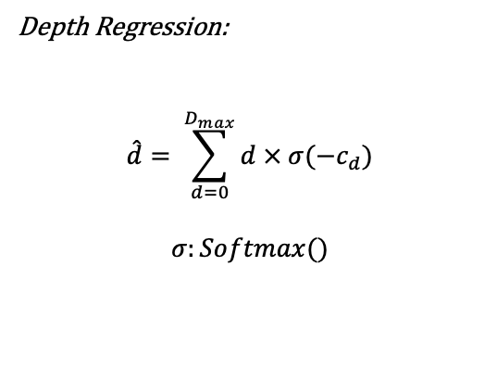
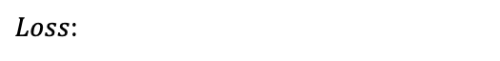
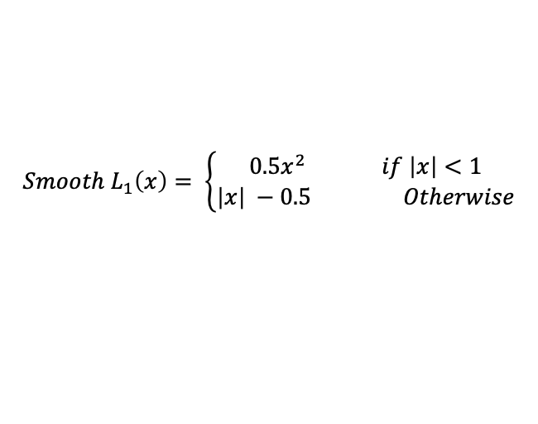
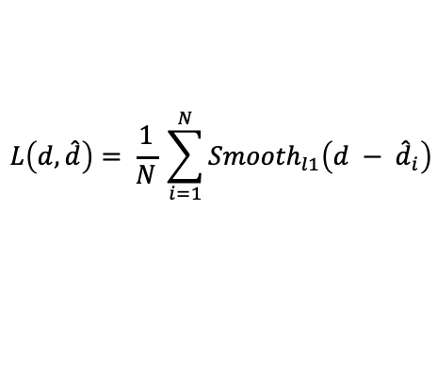
Network Architecture Depth Regression & Loss
Depth Regression:
$$\hat{d}= \sum_{d=0}^{D_{max}}{d × σ(−c_{d})}$$
$$σ:Softmax()$$
$Loss$:
$$L\left(d,\hat{d}\right)= \frac{1}{N} \sum_{i=1}^{N}{{Smooth}_{l1}\left(d − {\hat{d}}_{i}\right)}$$
$$Smooth L_{1}\left(x\right)= \left\{\begin{aligned}{0.5x}^{2} if \left|x\right|<1 \\ \left|x\right| −0.5 Otherwise\end{aligned}\right.$$
Notes:
Soft argmin:
is fully differentiable and capable of regressing a smooth depth estimate. First, the predicted costs (\textit{c\textsub{d}} for each depth, \textit{d}) from the cost volume are converted to a probability volume by taking the negative of each value. The probability volume is then normalized across the depth dimension with the softmax operation, $\sigma$(.). The sum of each depth, \textit{d}, weighted by its normalized probability, is taken. This operation is fully differentiable and allows for training and regressing depth estimates.
[\hat{d} = \sum\limits_{d=0}^{D_{max}} d \times \sigma(-c_d) \eqno{(4.1)}\]
Because of the depth regression, we adopt the smooth L1 loss function to train the proposed model. Smooth L1 loss is widely used in bounding box regression for object detection because of its robustness and low sensitivity to outliers, as compared to L2 loss.
Slide 12:

Slide 11
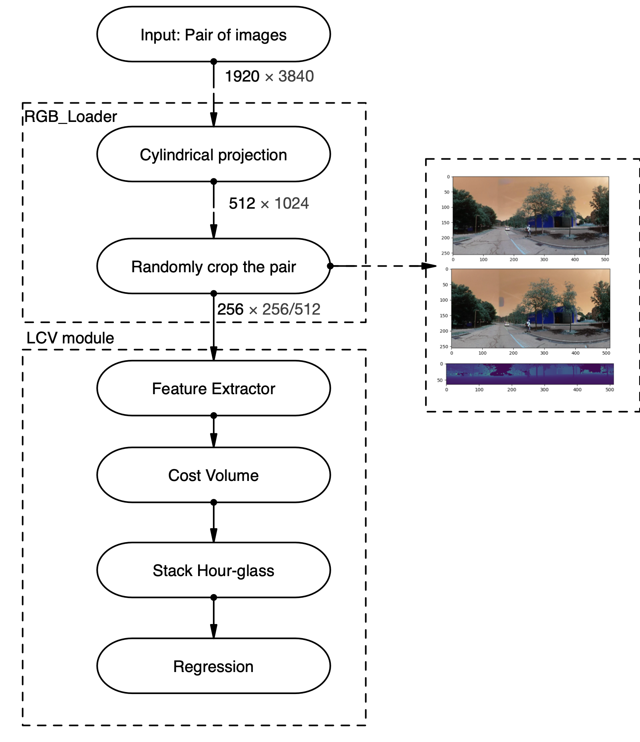
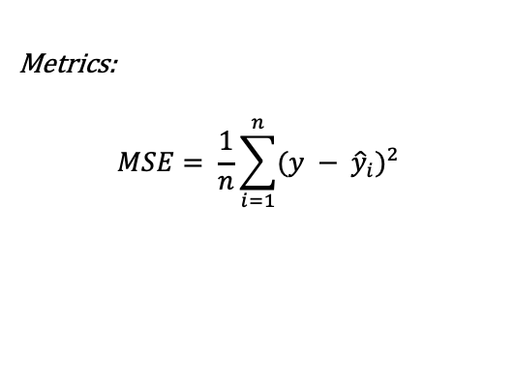
Experiments & Results
Metrics:
$$MSE= \frac{1}{n}\sum_{i=1}^{n}{{(y − {\hat{y}}_{i})}^{2}}$$
Code diagram.

Slide 12
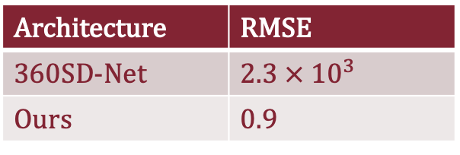
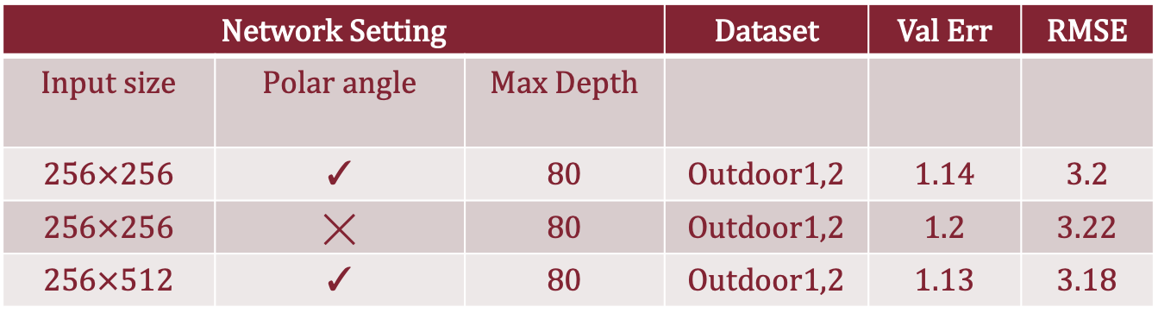
Experiments & Results
Table 1. Comparison of 360SD-Net architecture and ours on the dataset Outdoor_1.
Architecture | RMSE
360SD-Net | 2.3 $× {10}^{3}$
Ours | 0.9
Table 2. Ablation study of our architecture
Network Setting |  |  | Dataset | Val Err | RMSE
Input size | Polar angle | Max Depth
256$×256$ | ✓ | 80 | Outdoor1,2 | 1.14 | 3.2
256$×256$ | ╳ | 80 | Outdoor1,2 | 1.2 | 3.22
256$×512$ | ✓ | 80 | Outdoor1,2 | 1.13 | 3.18

Slide 13
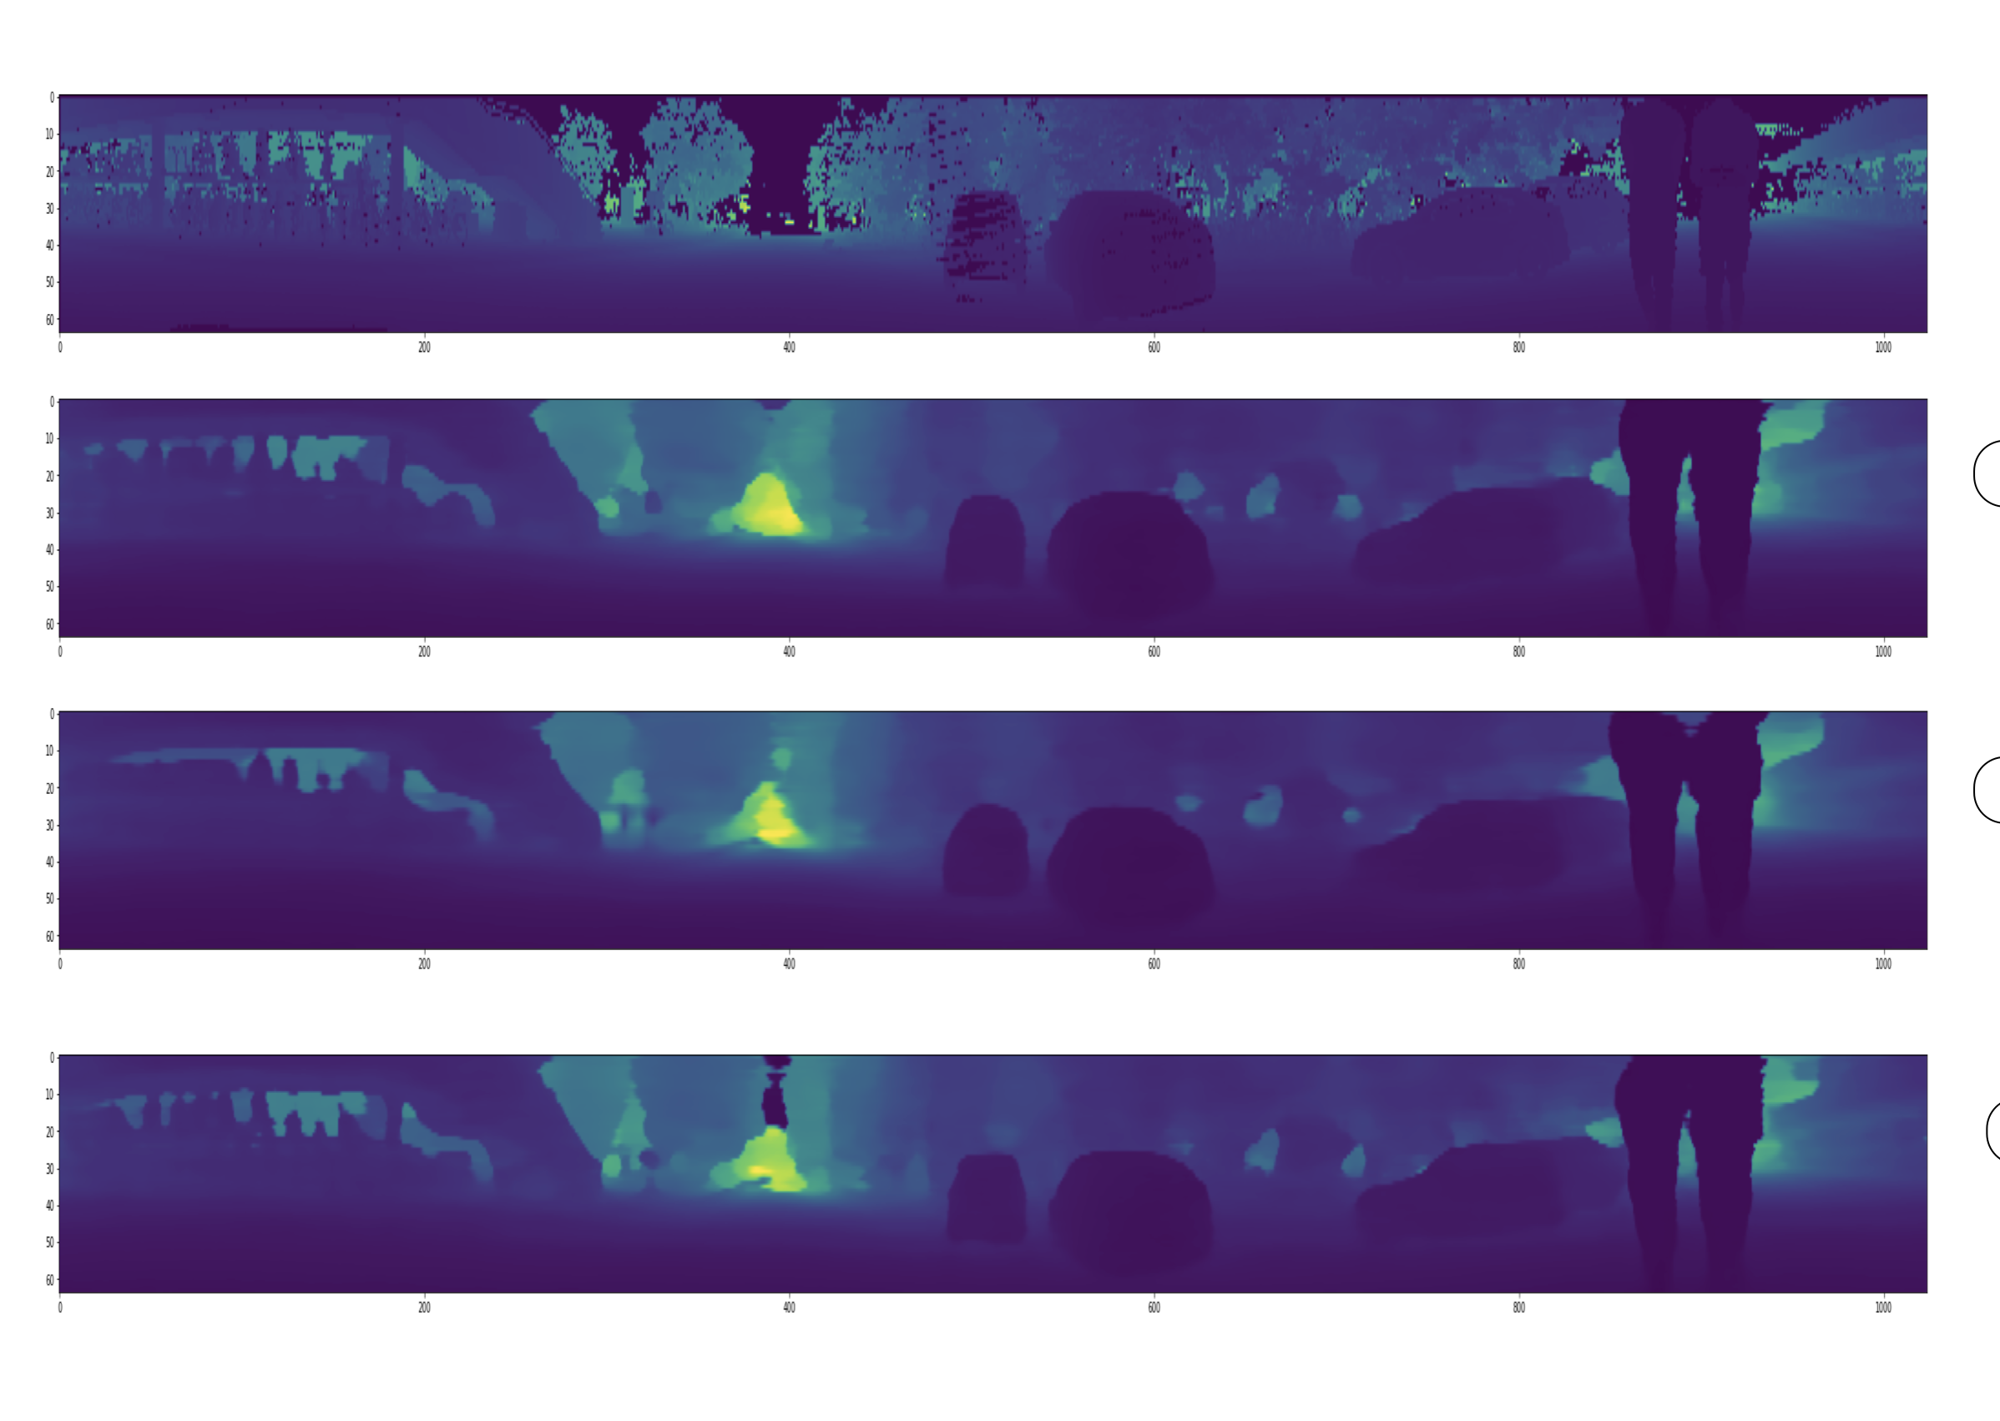
Experiments & Results
Ground-truth

Slide 14
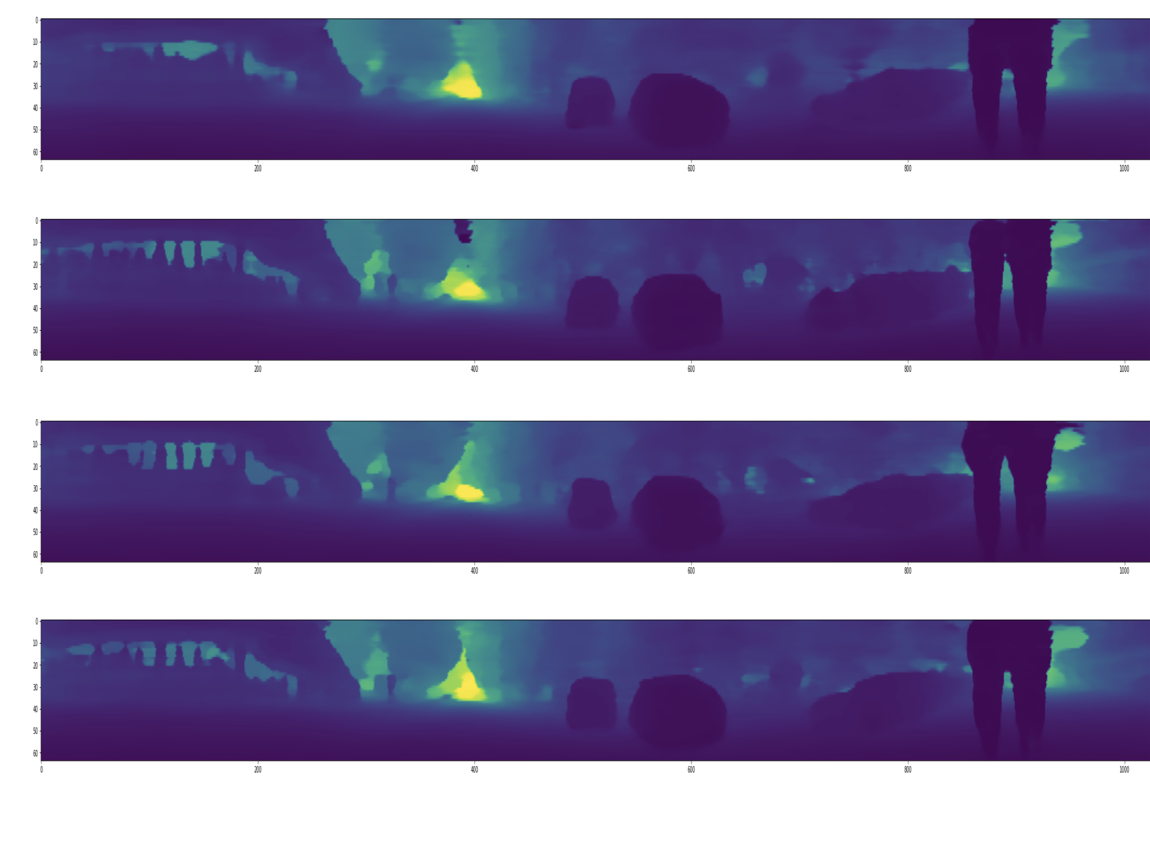
Experiments & Results

Slide 15
Conclusion
In conclusion, our research highlights the critical role of diversity in the dataset used for training and evaluating depth estimation models.
Although our current dataset presents a novel challenge for depth estimation in stereo 360°images, it falls short in terms of the number of samples and the variety of scenes represented. This limitation could potentially affect the generalizability of our findings and the performance of the models in diverse real-world scenarios.

Slide 16
Future studies
The dataset can get diverse and increase in terms of cardinality so further experiments would get performed.
The model itself can get better by introducing proper modules. This can be done by additional geometry information.
The setup can be upgraded by using OS-128 Lidar, this enable the possibility of extracting depth-maps with height of128.
This is also possible to extract different topics such velocity and position from lidar by using RoS which can be useful.

Slide 17
Thanks for Your attention!

Slide 18
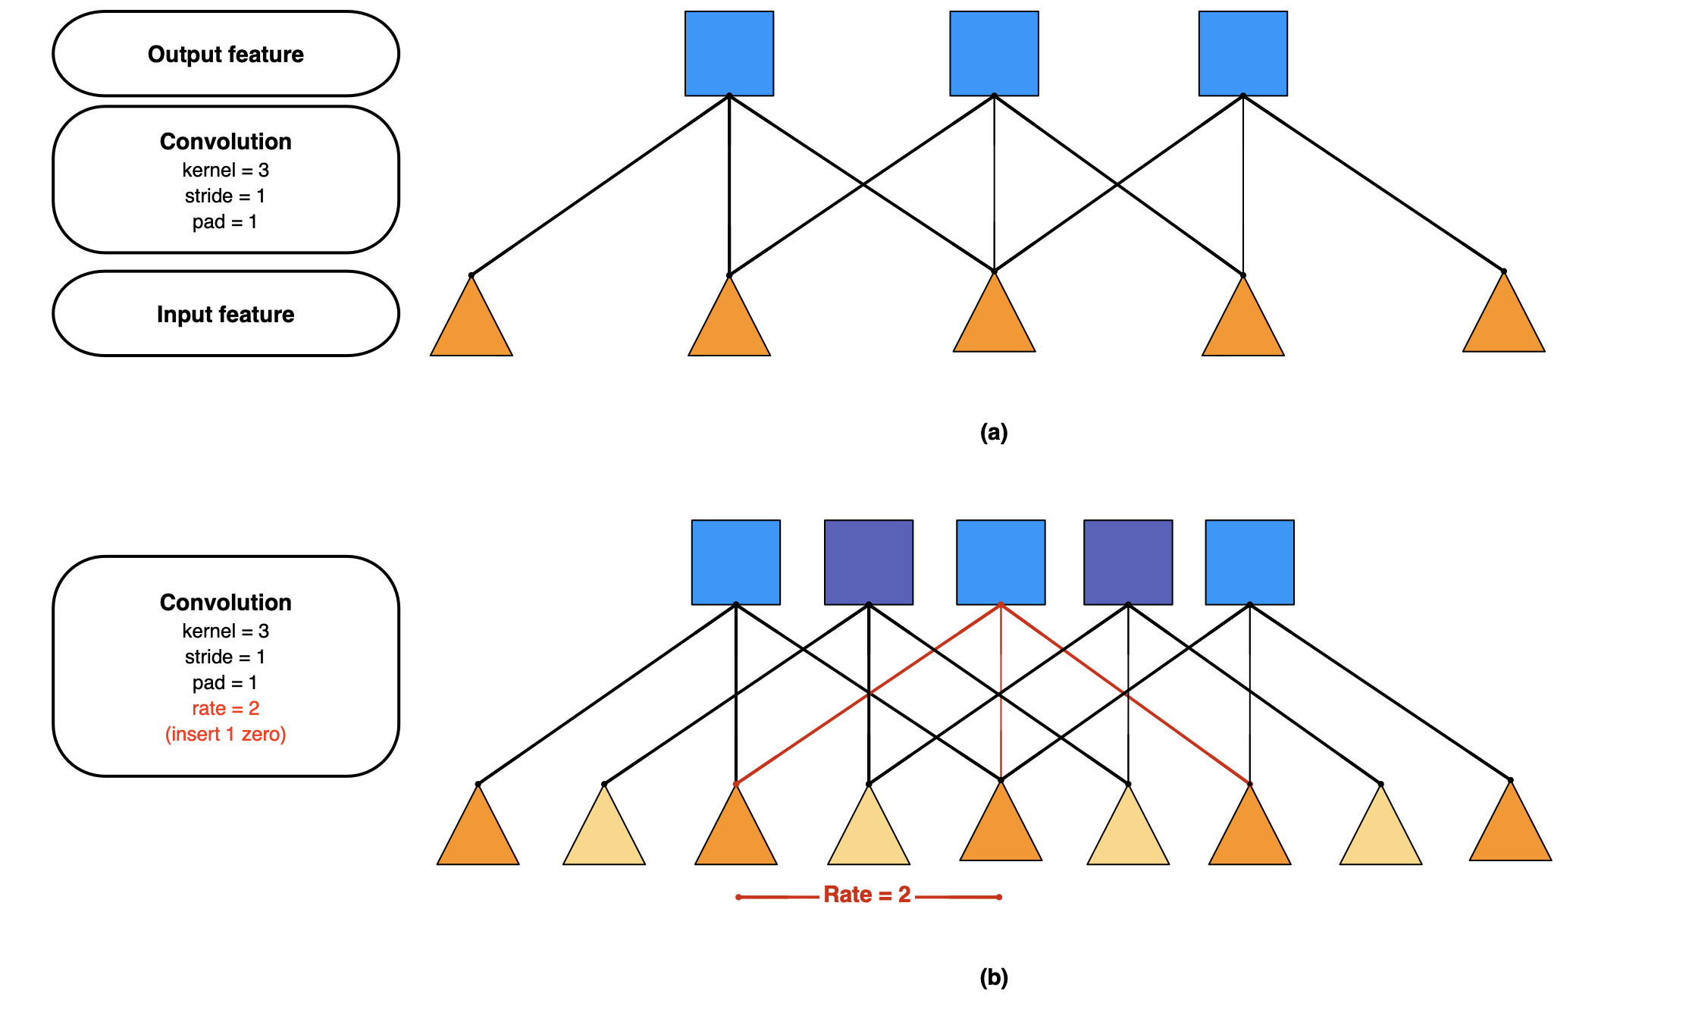
Network Architecture ASPP
Illustration of atrous convolution in 1-D. (a) Sparse feature extraction with standard convolution on a low resolution input feature map. (b) Dense feature extraction with atrous convolution with rate r = 2, applied on a high resolution input feature map.
Notes:
The ASPP module uses different dilation rates to capture features at different scales. Astrous convolution applies convolutions with gaps between kernel values.. The gaps control the output feature map’s spatial resolution, which leads to have a larger receptive field without increasing the number of parameters. And pyramid pooling technique generate a fixed length vector for each divided region of feature map The fixed-length vectors from each region are concatenated to form the final feature vector, allowing the network to capture features at multiple scales and improving the accuracy.

